Slide 1

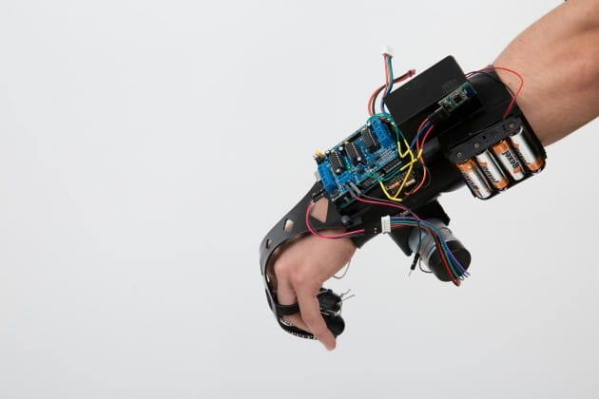
Graduation Project
A Glove For Deaf
E28

Slide 2

Group Names(E28)
Nader Mahmoud Taha
Mahmoud Said
Mahmoud Mohamed Ali

Slide 3

Introduction
Deaf use the sign language to be in touch with surrounding people, unfortunately, the people must learn or know the sign language to connect with them.
So, we will implement a device that can transcript the sign word on LCD: Five flexible sensors must be put on all fingers, respectively.
Flexible sensors fast response detect any motion of fingers.
According to the posture of fingers, the relative meaning will be printing on the LCD.
By using Micro Controller ATmega32 :
1.We detect fifteen different motions of fingers, every finger must has an individually one.
2.According to the position of pack of fingers, the relative word will be printed on LCD.
3

Slide 4

And here we review the signs that we can get their meaning by our Device.
4

Slide 5

I wish you a happy life

Slide 6

I love you

Slide 7

See you later

Slide 8

Quotation

Slide 9

Letter W

Slide 10
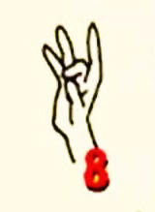
Number 8

Slide 11

I’m really love you

Slide 12
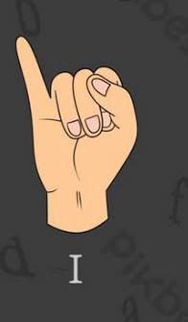
ME

Slide 13

I agree

Slide 14

I’m not sure

Slide 15

This’s terrible

Slide 16

Excellent

Slide 17

Good Job

Slide 18

Thanks

Slide 19

Victory !

Slide 20
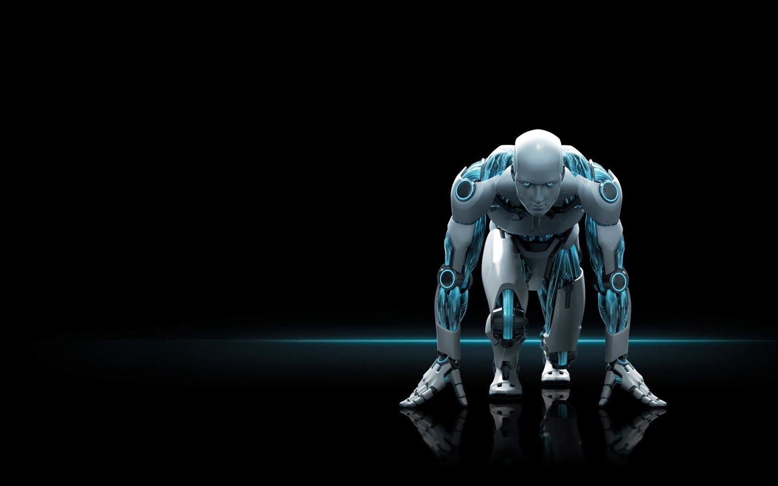
And in the end, we always strive to develop and advance for an easier and better life.
20

